Slide 1
Java arendaja õhtuõpe

Slide 2
HTTP
http://www.test.com:8080/employees/5?tag=boring
Protocol
Host
Port
Path
Query

Slide 3
@Annotations
@RequestMapping(„company“)
@GetMapping(„/employee/{id}“)
@PathVariable(„id“)
@RequestParam(„testId“)
Defines first part of path
Defines lat part of path
Variable id is read from path
testId is taken from query part of URL

Slide 4
SQL - INSERT
INSERT INTO table_name (column1, column2) VALUES (‘value1’, ‘value2’);

Slide 5
SQL - SELECT
SELECT * FROM table_name;
SELECT column1, column2 FROM table_name;
SELECT * FROM table_name where column_name = ‘column_value’;

Slide 6
SQL - UPDATE
UPDATE table_name SET column_name = ‘column_value’ WHERE id = 5;

Slide 7
SQL - DELETE
DELETE FROM table_name WHERE id = 5;

Slide 8
Exercise 2 (REST endpoint)
Create a DTO object for employees
Create a class variable of List of employees
Make 5 endpoints
/bank/createAccount - creates a new account
/bank/getAccountBalance - returns account balance
/bank/depositMoney – adds money to accont
/bank/withdrawMoney – withdraws money
/bank/transferMoney – transfers money between accounts

Slide 9
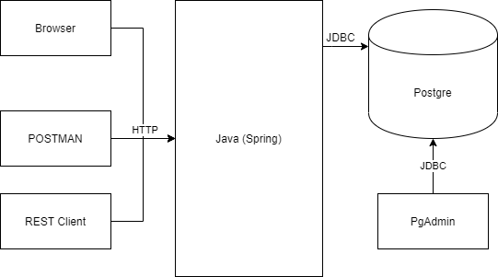
Architecture

Slide 10
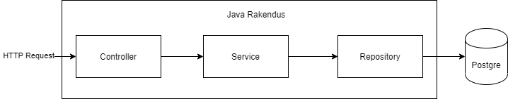
3-tier Architecutre

Slide 11

Normal way vs Dependency Injection

Slide 12
Inversion of Control
It is a process whereby objects define their dependencies, but don’t instanciate them
The container injects those dependencies
This process is fundamentally the inverse, hence the name Inversion of Control (IoC),
Also known as Dependency Injection

Slide 13
Spring Bean
In Spring, the objects that are managed by the Spring IoC container are called beans.
ApplicationContext represents the Spring IoC container and is responsible for instantiating, configuring, and assembling beans.
https://docs.spring.io/spring/docs/3.2.x/spring-framework-reference/html/beans.html

Slide 14
Bean Creation
Many Beans are automatically created by Spring Framework
All classes that are annotated with @Component annotation is a bean. (incuding @RestController, @Controller, @Service, @Repository, …)

Slide 15
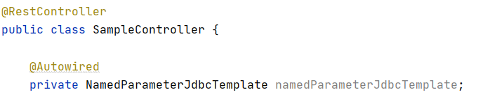
Using Beans @Autowired
If class variable has @Autowired annotation the field is automatically instantiated

Slide 16
Controller
Annotated wih @Controller or @RestController
Use @GetMapping, @PutMapping, … to define endpoints
Inject service into controller (using @Autowired or constructor injection)

Slide 17
Service
Annotated wih @Service
Inject Repository class
Write business logic here (everything that is not database call or endpoint definition)

Slide 18
Repository
Annotated wih @Repository
Inject NamedParameterJdbcTemplate
Write all database queries here (SQL)
Only 1 SQL call per method

